Slide 1
Volunteer Guru
Charly Garcia, Carlos Perez, Romanov Andre, Paul Nicowski, David Ensign

Slide 2
SUMMARY / OVERVIEW
Organizations search for Volunteers
* based on their interests or location.
Volunteers search for Organizations
* based on their interests or location.
Organizations can create events and invite users to participate
Volunteers can join events
Volunteers can ‘follow’ organizations
* for updates and news on future events

Slide 3
Effort/Stats
Roles:
Charly - Leader/Flex
Carlos - Front/GUI
Romanov - Back-end prog.
Paul - Back-end prog.
David - Document/Flex
Meeting Hours | 35~
Classes | 17
Lines of Code, java | 1467
Lines of Code, fxml | 4287
GitHub Commits | 32

Slide 4
Volunteer Guru Video

Slide 5
Legacy Slide
Future implementation:
Transfer from .txt file to SQL
Messaging System
UI Improvements
Challenges:
System Version Confliction
Text File Limitations
Schedule Conflicts
Differences in Coding Style

Slide 6
Legacy Slide
Advice for Future Groups:
Have a Common Goal
Plan Properly
Keep Constant Communication
Leave Comments Anywhere Necessary
Could’ve Done Differently:
Discord
Use Resources (Professor/Chelsea)
Program Requirements
Effective Work Schedule

Slide 7
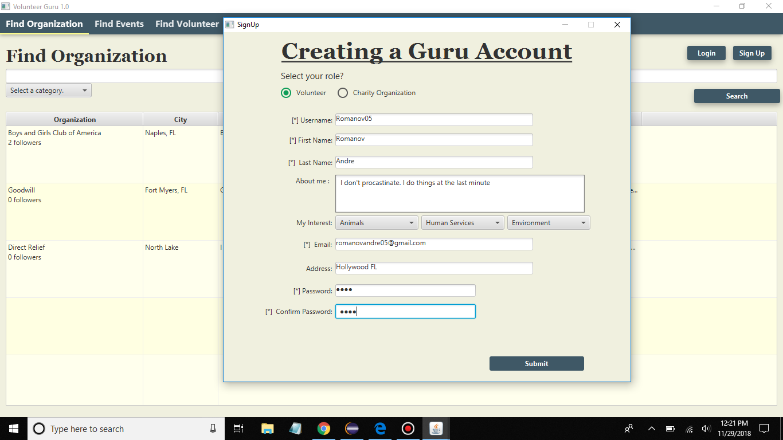
Screenshots of final program

Slide 8
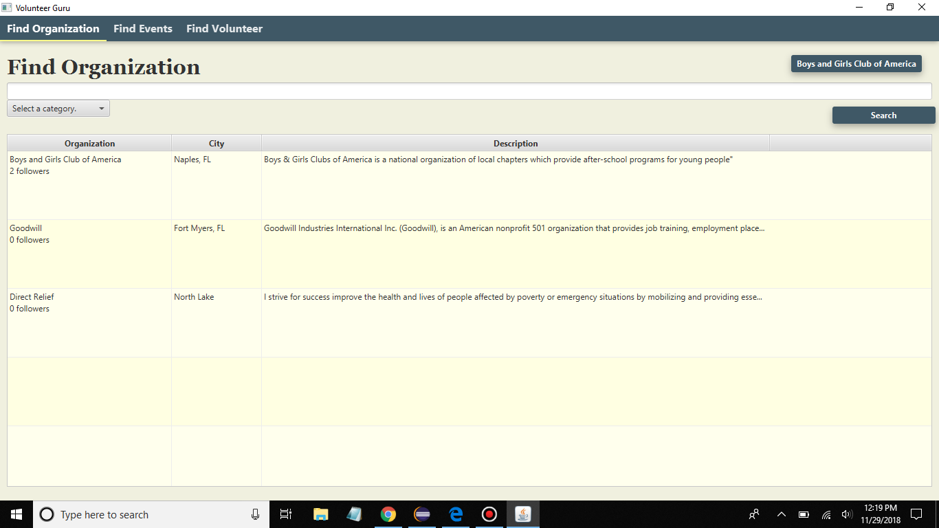
Screenshots of final program

Slide 9
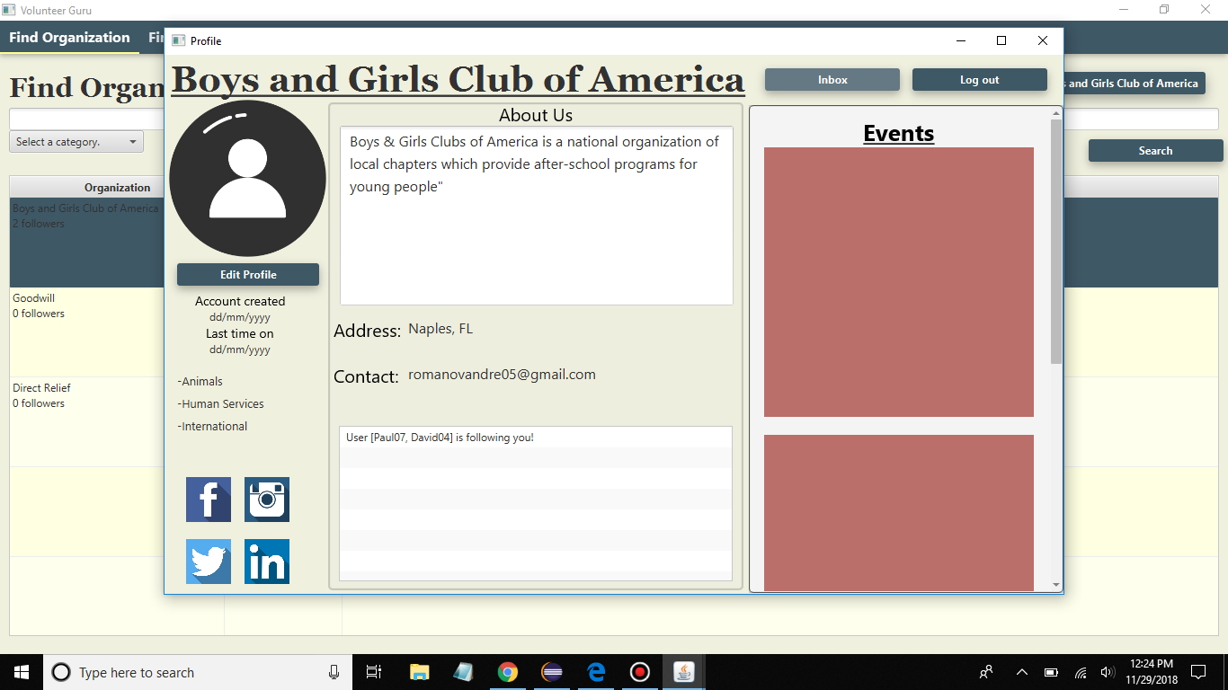
Screenshot of final program

Slide 10
Thank you.

